Slide 1
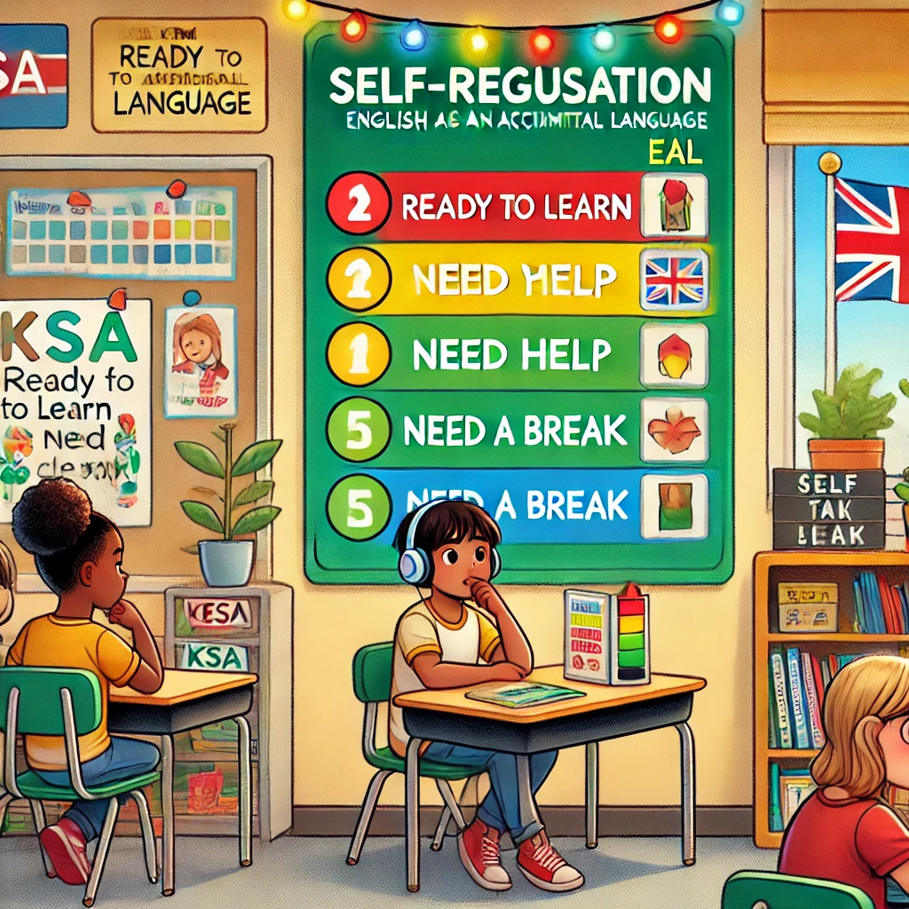

Slide 2
Self- Regulation Strategies for EAL Students:
EAL Learners need to feel safe, secure and have a sense of belonging to their school and wider community to maximise their opportunities for success. This is especially important for children seeking asylum (McIntyre and Abrams, 2021). It is important to build and promote an inclusive environment where everybody is a valued contributor to school life.

Slide 3
EAL Simulation : Cognitive Load
EOKSLENT
MRTISAPSMOOEH
PIEELCS
SYHITOTSHSOEPN
ITRDSOAE
CLNEOIRESTC
ACRLIEG
SURREPSE
ONACMNIMIOTUC
ONVOTUILE
Task:
Using your non-dominant hand, write down and unscramble the following words.
Consider the Following:
How did you feel physically and emotionally?
Look at the content, did it reflect your thoughts, or did you take any short cuts during the task?
Does the writing sample look like some of the work produced by your students?

Slide 4
How Did You Get On?
According to cognitive science, the working memory is able to process about 4 to 7 tasks at a time.
This is a perfect example of why it is key to promote strategies to aid EAL students manage the cognitive load.
Where to place the paper
Ideas
Frustration
Letter formation
Motivation
How to hold a pen?
Learning boundaries
Distractions
Other factors to consider: being in a different culture (Links to behaviour management) e.g. eye contact/ New routines / New rules and processes and Emotions e.g. Nervous , frustration
Notes:
Remember that the working memory can only process 4- 7 tasks at a time. As you were writing how many tasks did you have to do ?

Slide 5
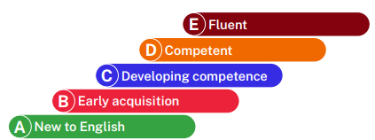
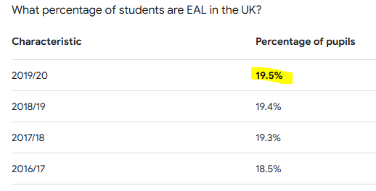
Why Is This Relevant?
The common and sometimes misunderstood fact is that according to the Bell foundation introduced the EAL assessment framework for schools. The guidance is organised according to the five assessment bands A–E.
So why do we have misconceptions:
Learners do not always fit neatly into one band and neither do activities.
The learning challenges faced by EAL students are not just about literacy, but we also have to consider how they are affected by knowledge transfer (increase in the cognitive load) and behaviour management.
Students learnt by making reference to prior knowledge.

Slide 6
What Is Cognitive Load?
CLT is the mental energy expended to do a task (Dahlstrom- Hakki 2013). If we learn anything new, the cognitive load is greatest in the beginning.
Working in another language puts extra pressure on the cognitive load affecting students’ higher order skills. E.g. students struggle with extended writing tasks (Hecker 2020).
Every learning task is made up of Extraneous load (anything that is not part of the learning goal e.g. focus, sequencing steps and spelling) and intrinsic load (core elements of the learning task ), so a balance is required for students to process information.

Slide 7
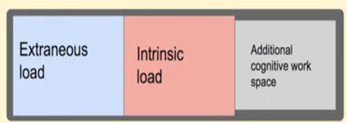
Extraneous and Intrinsic Load
We need to aim to have a balance between extraneous and intrinsic load.
Imbalances are causes by students lacking core subject skills, and when EAL students spend a lot of their cognitive space reading vocabulary and writing.
This means that students feel frustrated which leads to off task behaviours and incomplete work.

Slide 8
Self-Regulation Strategies
EAL learners (bands D and E) can engage independently with curriculum content across the four domains of listening, speaking, reading and viewing, and writing.
But they sometimes do not understand cultural references (for example, to streamed videos, nursery rhymes or British historical events), particularly if they have arrived recently from abroad.
They may also make some errors, such as using the wrong prepositions in phrasal verbs, using articles (an, a) incorrectly or omitting them.
Learners at this band need cultural references explained clearly to them and personalised feedback on their spoken and written production to help them use language even more accurately and appropriately.
Key Strategies:
Modelling (I- WE - YOU).
Reference to cultural capital e.g.: in Geography we study the regeneration of Newham / London Olympics (what does poverty look like in the UK?)
During independent writing tasks, educators should provide some WAGOLLs (What A Good One Looks Like), and teach phrases for explaining and justifying points of view, refuting ideas, and summing up.
Stages of Self- regulation:
Planning
Monitoring
Evaluation

Slide 9
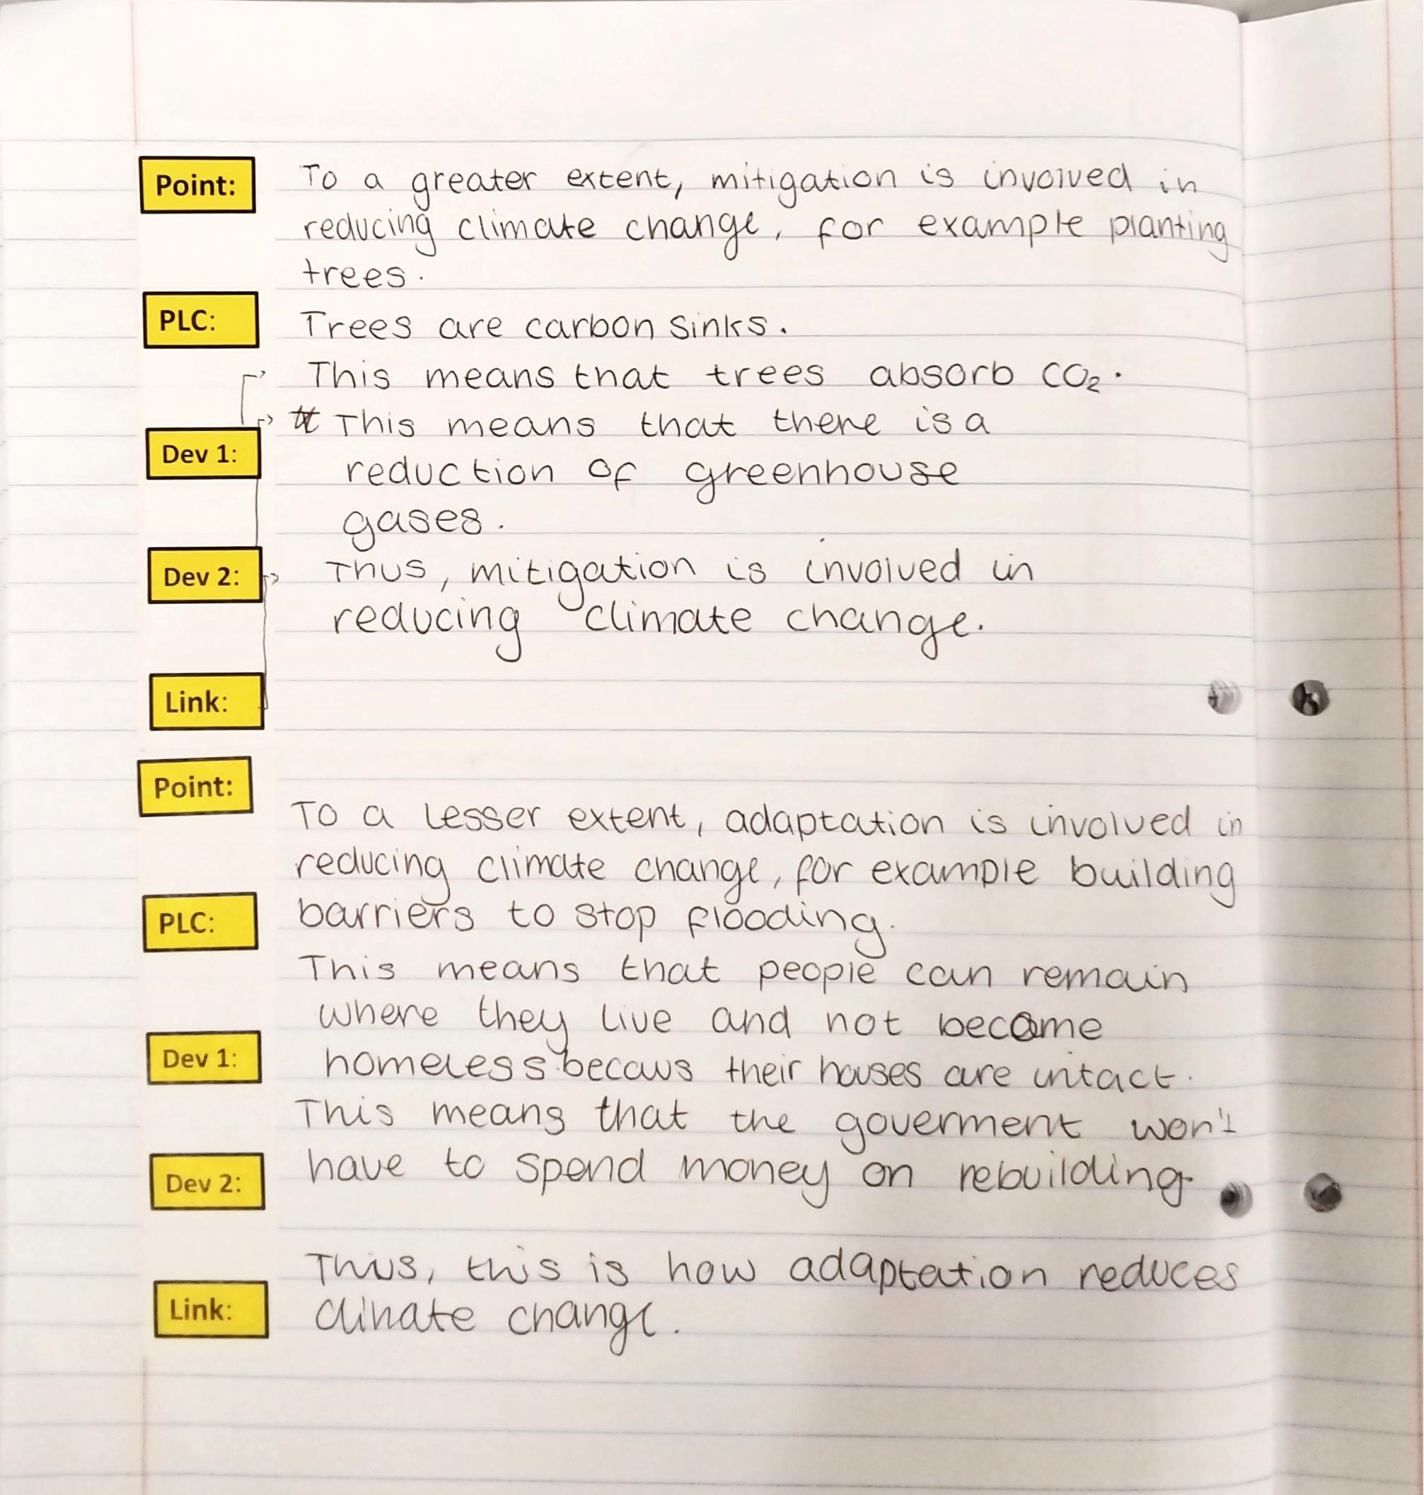
Example of Student Work: PDDL Stripes
Situation: Student A (who is EAL) was struggling with the intrinsic load as the student joined late in the year. Thus, they had not developed the core writing skills most students developed during KS3.
Action: Provided student with a Stripe showing the student the required writing structure. This allowed the student to self-monitor as they wrote during the ‘YOU’ phase.
Result: Student was able to learn how to write like a geographer. Note: even when I removed the scaffolding over time, the student had automised the writing style.
Notes:
Insert student work

Slide 10
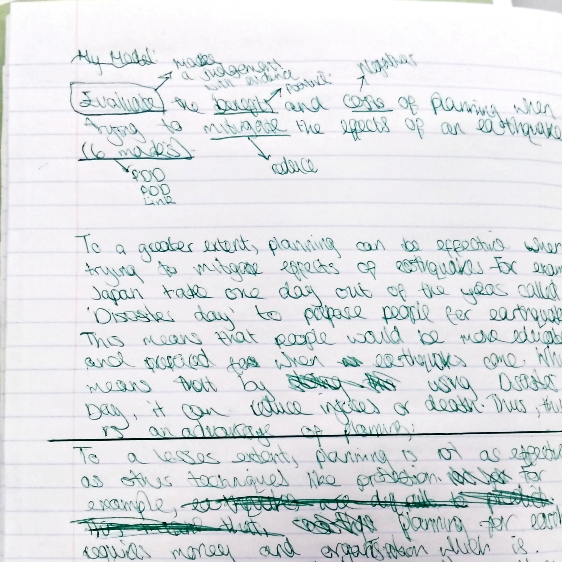
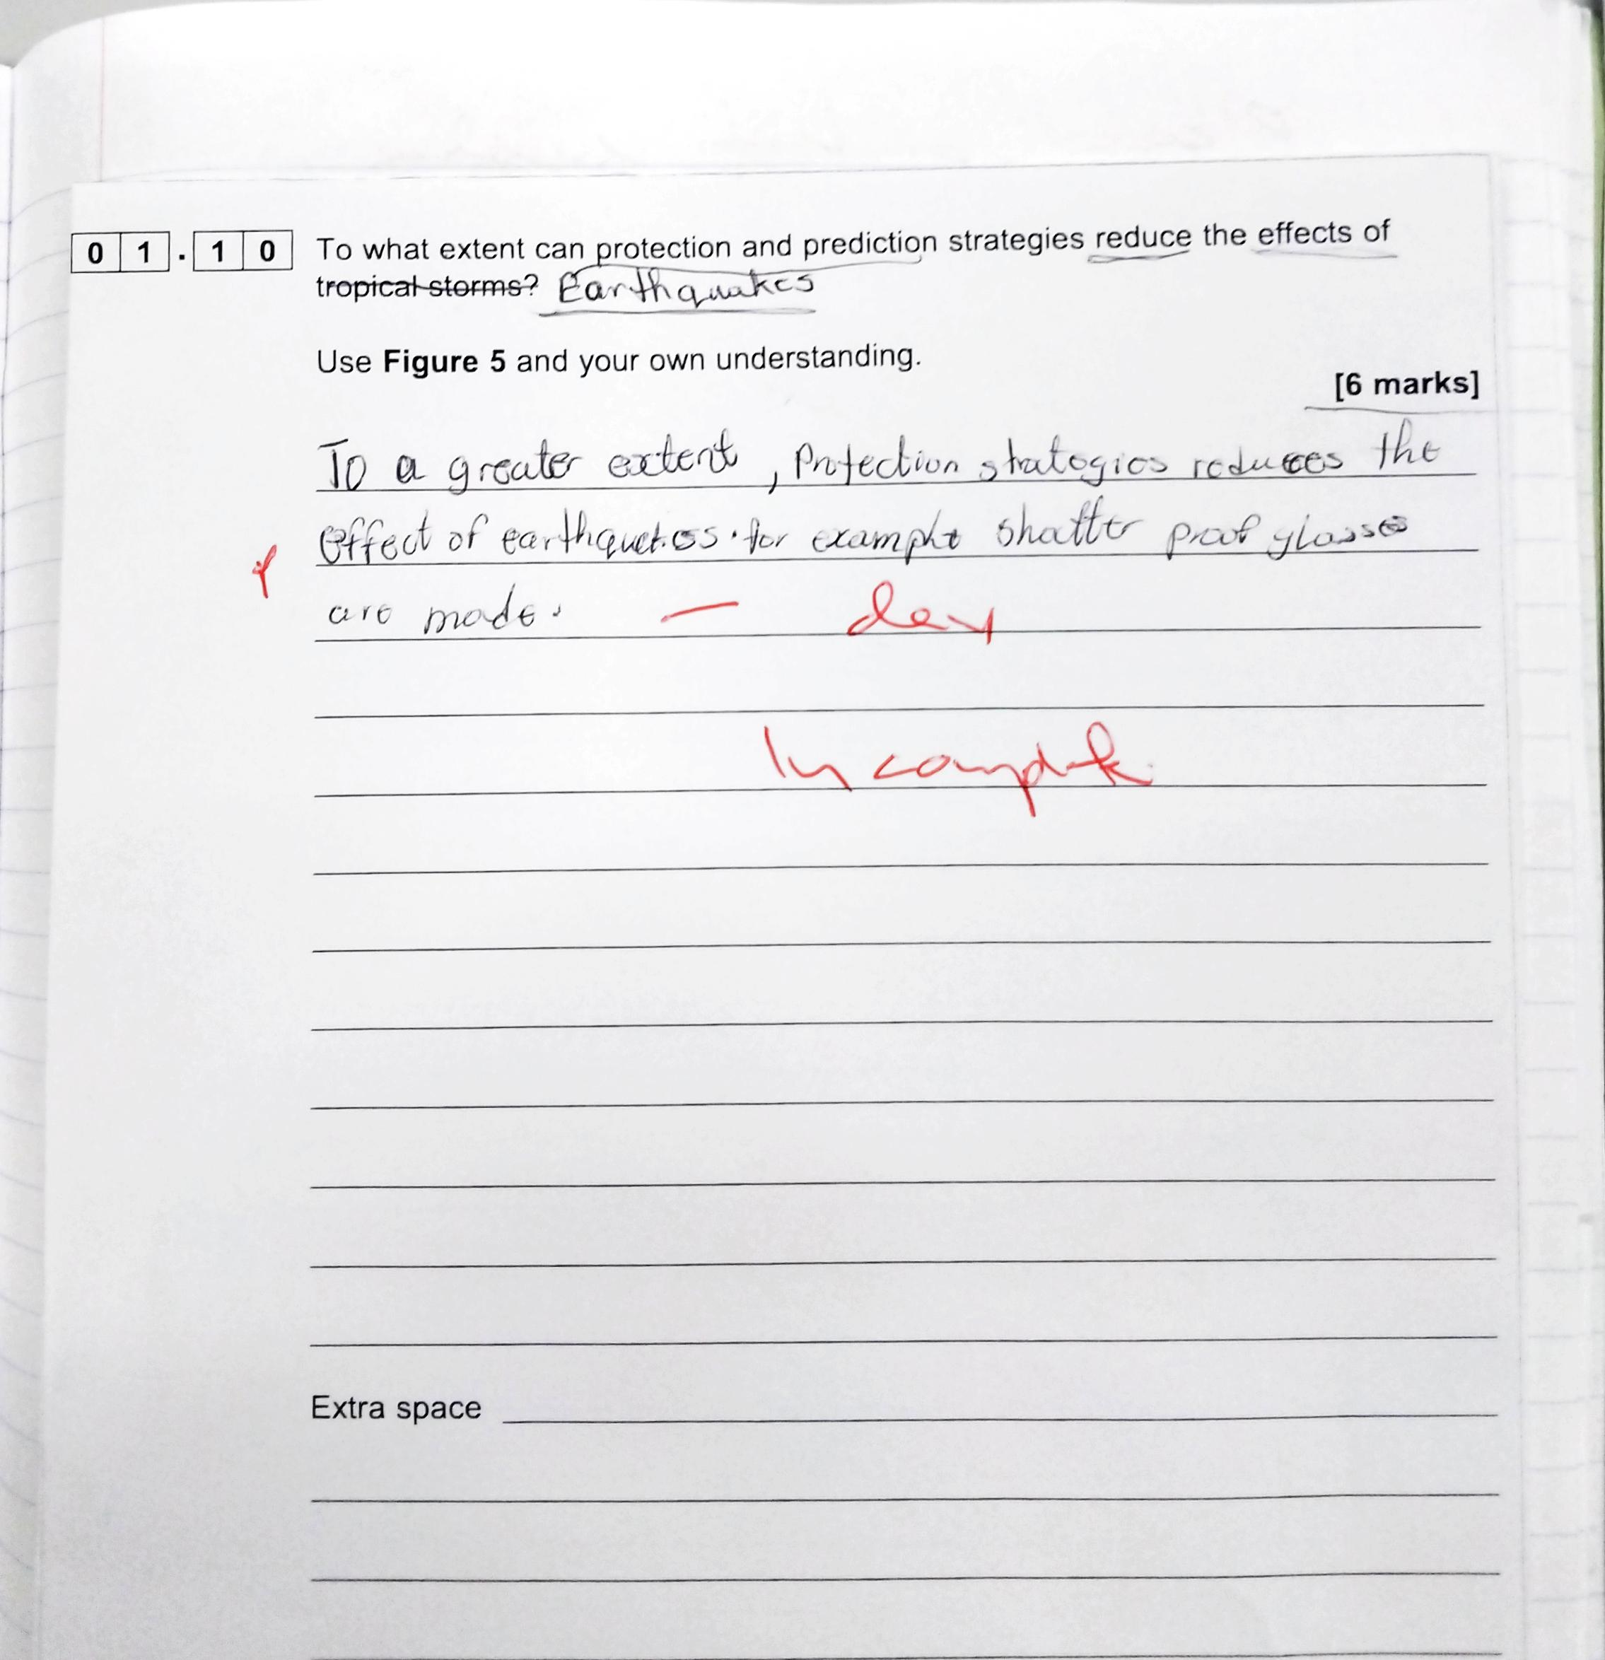
Example of Student Work: BUG Exam Questions
Situation: GCSE Geography is designed to assess reading age, verbal reasoning, and designed for pupils for whom English is their first language. (Mainly the command words.)
Action: From KS3 onwards, students are taught how to BUG (Box, Underline and Glance).
Result: This allows EAL students to understand the requirements of the questions which allows students to plan better answers
Notes:
Insert image of student work

Slide 11
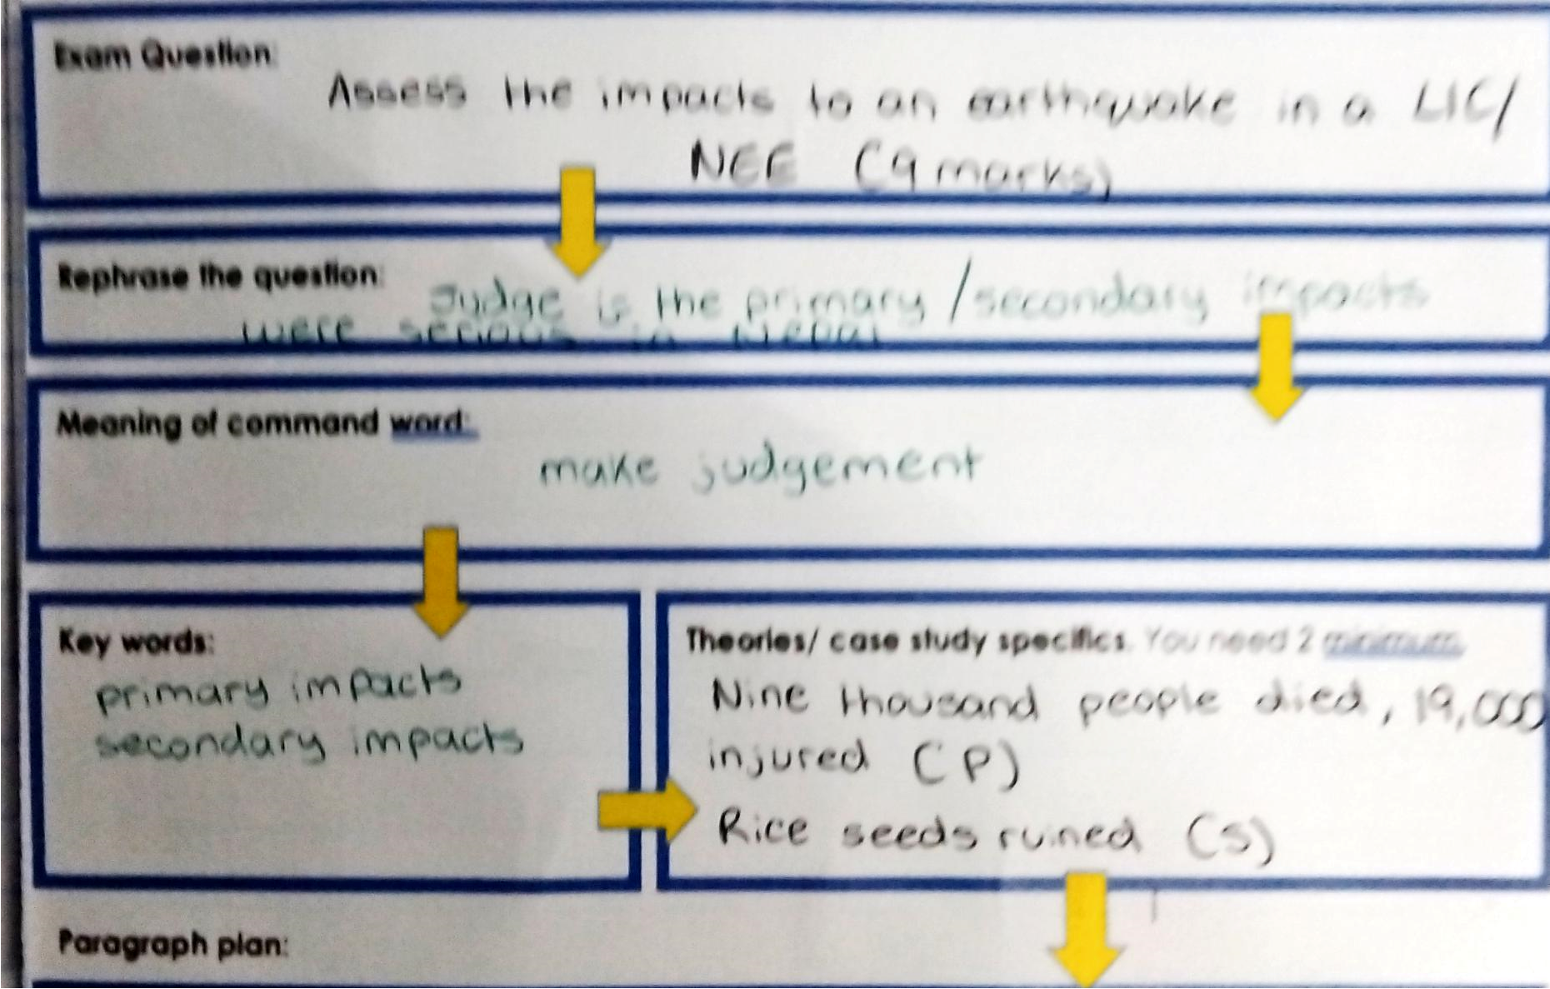

Slide 12
Set high expectations: As educators, avoid the temptation to “dumb down” or simplify the curriculum for EAL learners and instead seek to amplify it through judicious use of scaffolding. It is vital to recognise that the cognitive and academic abilities of learners with EAL are separate from their current ability to use English. Like all learners, those with EAL, will benefit from being motivated and challenged in the classroom.
Create a curriculum which makes assessment and feedback relevant to the EAL learners. Many formal standardised tests designed to assess reading age, verbal reasoning, and reading comprehension in English are designed for pupils for whom English is their first language. Thus, they are of limited use for EAL learners as they will not, on their own, give an accurate picture of the progress of a learner using EAL.

Slide 13
Positioning the Band E learner as an expert. At Band E (fluent), learners will be able to support other learners who share a common language by becoming a near-peer role model. Elevating learners to the position of expert will increase their sense of self-efficacy, which will in turn impact their attitude and performance in school.
Encouraging learners to take an active role in identifying and creating opportunities for inclusion in the school. This might be through helping to set up and run multilingual clubs.

