Slide 1
Dan Dudson
PRINCIPLES OF INCLUSIVE LEADERSHIP

Slide 2
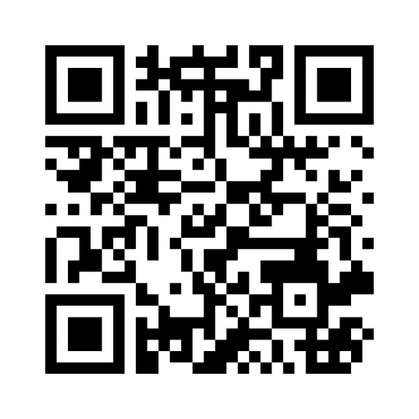
WHAT DOES INCLUSION MEAN TO YOU?
Use the code to share your thoughts.

Slide 3
‘KIDS DO WELL IF THEY CAN’
Dr Ross Greene

Slide 4
A ‘bolt on’
TRADITIONAL INCLUSION MODEL
Not part of the main school
Seen as ‘additional’
Siloed response to need
Interventions not shared with relevant staff
Conflict of ‘ownership’ of student

Slide 5
ALL CHILDREN HAVE LEARNING, WELLBEING AND SAFEGUARDING NEEDS.

Slide 6
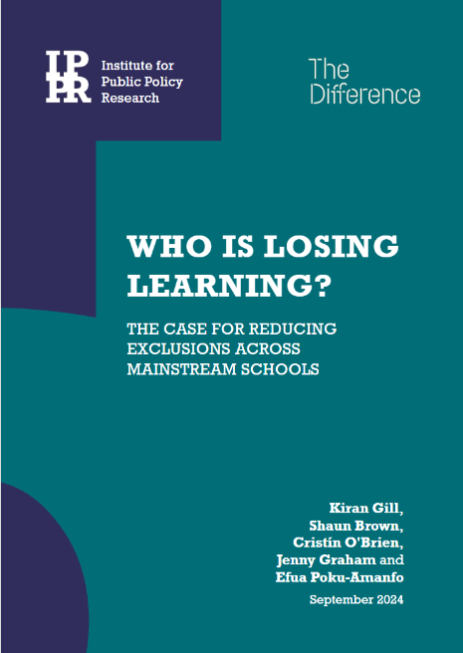
WHO’S LOSING LEARNING?
Disproportionate impact on specific student groups
Students with SEND are 3 times more likely to be permanently excluded than those without SEND
Children in need and on child protection plans are 5 times more likely to be suspended and 8 times more likely to be permanently excluded
Students with Free School Meal eligibility are 1.5 times more likely to be permanently excluded than their non-FSM peers
Boys are twice as likely to be permanently excluded as girls
Notes:
https://nasen.org.uk/news/permanent-exclusions-and-suspensions-show-pupils-send-disproportionately-affected
https://explore-education-statistics.service.gov.uk/find-statistics/suspensions-and-permanent-exclusions-in-england/2022-23
https://www.ethnicity-facts-figures.service.gov.uk/education-skills-and-training/absence-and-exclusions/permanent-exclusions/latest/

Slide 7
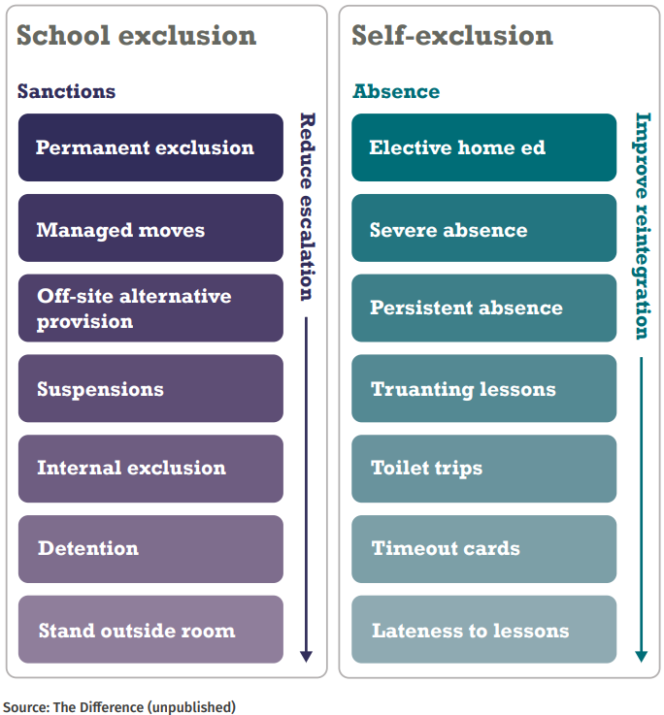
EXCLUSIONS CONTINUUM

Slide 8
PRINCIPLES OF INCLUSIVE LEADERSHIP
01
02
03
Relational practice
Asset based practice
Trauma informed practice
Building and maintaining meaningful, trust based relationships to support well-being and positive outcomes
Identifying and leveraging strengths rather than deficits to promote positive development
Recognising the impact of trauma and integrate this into policy and interactions to create a safe and supportive environment

Slide 9
RELATIONAL PRACTICE
Task
Turn to the person next to / near you. Share a time when a relationship with a teacher made a difference in your life.
Think about
What made that relationship impactful?
How did it influence your learning or behaviour?

Slide 10
RELATIONAL PRACTICE
Why it matters
  Supports student engagement and belonging
  Enhances well-being and emotional regulation
  Builds trust between students, staff and families

Slide 11
ASSET BASED PRACTICE
Collaboration
Cultural responsiveness
Engaging families, communities and peers as resources to support learning
Valuing diverse backgrounds and integrating them into learning
Empowerment + agency
Strength based teaching
Encouraging students to take ownership of their learning and see themselves as capable and valued members of the school community
Identifying and leveraging students’ existing knowledge and skills

Slide 12



What strengths
does this student
have?
What’s wrong
with this student?
How can I use
their strengths
to support them?
Why can’t they
do this?

Slide 13
‘KIDS DO WELL IF THEY CAN’
Dr Ross Greene

Slide 14
TRAUMA INFORMED PRACTICE
Trauma experiences can impact on our ability to regulate our emotions
Trauma experiences are personal. They are often unseen or unknown
Emotional literacy is essential to support trauma informed interactions

Slide 15

ATTACHMENT CYCLE
Feeling safe and loved
Express unmet need
Calms child
Response from carer
Need met

Slide 16
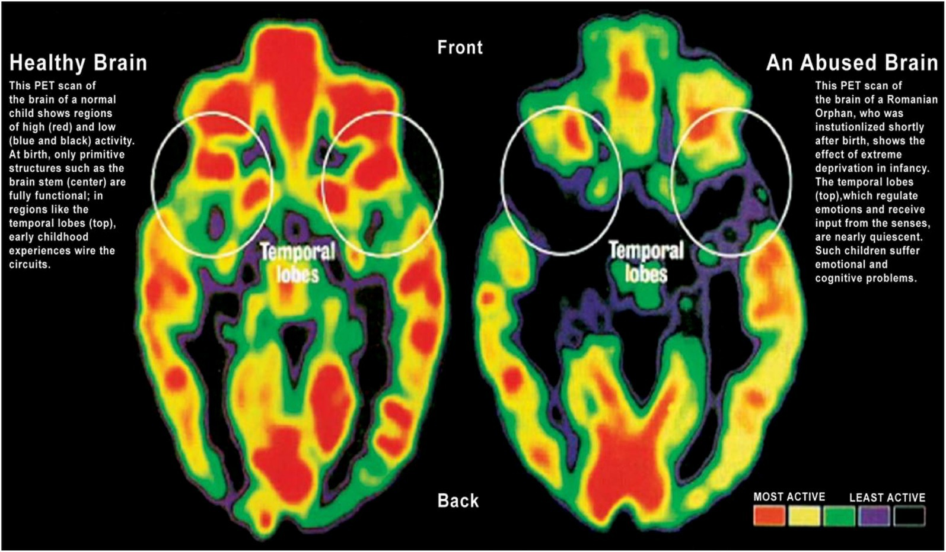
IMPACT OF TRAUMA ON A DEVELOPING BRAIN

Slide 17
DECISION MAKING NEUROSCIENCE
Motivation and resource seeking
Safety and connection
Threat and self protection
Panksepp, J. (1998) Series in affective science. Affective Neuroscience: The foundations of human and animal emotions

Slide 18
TRAUMA EXPERIENCES ARE PERSONAL.
THEY ARE OFTEN UNSEEN OR UNKNOWN.
Behaviour is a two-way channel of communication
We cannot assume that a child’s challenging behaviour is linked to the impacts of trauma

Slide 19
EMOTIONAL LITERACY IS ESSENTIAL TO SUPPORT TRAUMA INFORMED INTERACTIONS
BLUE ZONE
Sad, bored, tired, depressed,
helpless, guilt, disappointed,
unmotivated, lonely
GREEN ZONE
Happy, calm, motivated, proud,
confident, open, content,
cheerful
RED ZONE
Extremely heightened, anger,
rage, panic, terror,shame,
grief, no control
YELLOW ZONE
Excited, nervous, giddy,
impatient, silliness, frustration

Slide 20
EMOTIONAL LITERACY IS ESSENTIAL TO SUPPORT TRAUMA INFORMED INTERACTIONS
BLUE ZONE
Sad, bored, tired, depressed,
helpless, guilt, disappointed,
unmotivated, lonely
GREEN ZONE
Happy, calm, motivated, proud,
confident, open, content,
cheerful
Threat and self protection
Safety and connection
RED ZONE
Extremely heightened, anger,
rage, panic, terror,shame,
grief, no control
YELLOW ZONE
Excited, nervous, giddy,
impatient, silliness, frustration
Motivation and resource seeking
Threat and self protection

Slide 21
HOW MIGHT YOU BE MORE INCLUSIVE LEADERS?
Behaviour
Teaching and learning
Diversify assessment methods
Community engagement

Slide 22
KEEP IN TOUCH
daniel.dudson@ketteringscienceacademy.org

