Slide 1
Nonviolent Resistance (NVR) and New Authority (NA) in schools
Dr Tony Meehan
NVR Practitioner
PartnershipProjects
l
Notes:
Introduction:
Former head of a pupil referral unit in inner London. Retired in 2017 and still interested in working with children excluded from school. 2019 trained as NVR practitioner working with families and schools (on an individual pupil basis) Doctorate awarded in 2024 four parent perception, pupil referral units and their experiences

Slide 2
Once upon a time….
Once upon a time, adults had full authority over children. Children did what they were told, just because adults told them to. We call this “The Old Authority”
The focus was on control and obedience. It was built on fear, coercion, and sadly, left the door open to abuse (Omer et al., 2013).
l
Notes:
Focus on selected components of NVR in order to provide an overview of how it can operate to inform and influence culture change. Presence. Vigilant care. Deescalation Relational gestures. Support and support networks

Slide 3
Nowadays
These old values have been replaced – these days, we aspire to raise autonomous, questioning and enterprising children – the opposite of passive obedience.
How we manage behaviour has not evolved with our values, and how we respond is still rooted in the old, out-dated authority, which has never been questioned.
l
Notes:
It was at the pupil referral unit that I came to believe and needed to be alternatives to often highly punitive approaches taken. Many of the pupils had trauma in their background, when Neurodivergent and often came from areas of high deprivation. This became something of a mission, to explore how mainstream schools can help stem the flow of exclusions. Make the point about permanent exclusion from school leading to a state of permanent exclusion, from job opportunities, from Education opportunities, from a sense of belonging to wider society. We know this from prison statistics.

Slide 4
What makes a school a place where a young person wants to be?
Safety:
Physical
Psychological
Relational
Adult Presence:
Physical
Embodied
Systemic
Notes:
Current solutions from the Education System often seems to be increasingly punitive, excluding and unachievable behaviour policies set against a background of social deprivation on a scale that we haven’t seen in decades and a crisis in young people’s mental health
The ‘rules’ do nothing to keep young people safe or to build a sense of community that would make these young people want to go to school
Parents do not feel confident that schools are able to keep their children safe and often feel blamed by schools
Little acknowledgement of the Contextual Safeguarding framework

Slide 5
New Authority
Presence: a quality that makes people notice or admire you, even when you are not speaking
(Cambridge Dictionary)
l
Notes:
What I want to offer here is an introduction to an understanding of new authority, as reconceptualized through the principles and philosophy of nonviolent resistance.

Slide 6
Old Authority | New Authority | No Authority
Dictatorial | Influential | Permissive
Control Over | Self Control | Controlled by
Urgent / Immediate | Persistent / Responsive Long Term | Laissez Faire / Non Responsive
Punishment | Reparation and Restoration | Punished
Infallible | Authorised | Invisible
I want… I demand | We all need | You want… You demand
It’s your fault | Circular Causality | It’s my fault
Distant | Present | Absent
Limiting | Encouraging | Limited
Mystery / Secrecy | Transparency | Erasure / Disassociation
l
Notes:
What does presence actually mean? This is one of the most powerful offerings that NVR has to make. I will go on to explain how NVR articulate is presence in such a way that it can be introduced to any member of staff.

Slide 7
New Authority
I
We
Distant
Present
Control and Obedience
Self-Control
Hierarchy
Support
Natural consequences and Persistence
Immediate Consequences
Constructive Shame and Belonging
l
Notes:
The idea of self-control became hugely important in the pupil of our unit, where it became absolutely clear that he attempts to control people would result in chaos. My aim became one of developing staff to resist temptations to threaten dark punishments which inevitably would lead to pushback and failure, so we looked for something else.

Slide 8
NVR and New Authority in schools – a journey towards a culture shift
The toolkit / NVR
De-escalation
Delayed Response
Self-care
Relational Gestures
Support Network: Staff/Parents/Agencies
Protest methods: Announcement / Sit-with / campaign of concern
Resistance & persistence
Breaking taboos
The mindset - Vigilant Care
Open Attention
Focused Attention
Protective Action
New Authority - Presence
Physical
Embodied
Systemic
l
Systems Systems Systems
Notes:
NVR is a parent / caregiver centred, relational approach to responding
to the harmful and destructive behaviour of children and young
people, both in the home or in school / inpatient / residential settings. It
is based on a set of core principles that have their origin in socio-
political movements of the 20th century where marginalised groups
have resisted oppression and harm. The model was first applied to the
family setting by Professor Haim Omer and his colleagues at the
University of Tel Aviv from the mid-1990s and was brought to England
by Dr. Peter Jakob in 2002

Slide 9
New Authority
“….We no longer focus on the reactions of the child but on the actions of the adult…
… The authority figure begins to radiate authority because she now senses it in herself…”
(Haim Omer 2011)
l

Slide 10
Core principles of NVR
Learn to resist Non-Violently; Understand our own responses to the ideas of violence, Non-violence, authority and resistance in the context of social differences.
Think about escalation patterns and the logic of control; exploring ways to De-escalate including non-verbal communication and prioritising behaviours
Raise adult presence; the idea of not giving in and not giving up, creating a sense of belonging and safety for the young person within their environment
Resisting harm and carrying out peaceful protest in response to significant incidents of harmful and destructive behaviour
Build a caring community around each individual young person and their family; developing a support network of other adults who show care and support the parents / caregivers as they embed the approach
Reconcile and repair relationships with young people; developing reconciliation gestures and ways of making amends
l
Notes:
Keywords in this are: resist; understand own responses; escalation/de-escalation; non-variable communication; prioritising behaviours; adult presence; not giving in not giving up; belonging and safety; peaceful protest; building a caring community; support network; reconciliation and reparation; making amends.
What does an NVR framework have to offer?
How does this contrast with existing frameworks
Punishment has become psychological ‘exclusion’ rather than ‘physical’ What NVR offers is a community based way of resolving and responding to challenges

Slide 11
Elements of the Approach
Raising adult presence
Resisting and de-escalating violence
Rebuilding relationships
Peaceful protest
Building networks of support
l

Slide 12
INCLUSION
‘The child who is not embraced by the village will burn it down to feel its warmth’
BELONGING
l

Slide 13
Adult Approaches in New Authority
Focus on your own response:
Prioritise relationships - connect before you correct
Reduce demands to a manageable level
Prioritise behavioural goals (behavioural differentiation)
Delay your response (strike when the iron is cold)
De-escalate in the moment
Follow up later with planned acts of resistance
Use of relational/reconciliation gestures
l

Slide 14
Deescalation
l

Slide 15
EMBARRASSMENT
FEAR
GUILT
WALKING ON EGGSHELLS
WINNING AND LOSING
DIMINISHED AUTHORITY
INSISTENT
WORRIED ABOUT RISK
CONTROL
DEMAND
SHAME
Symmetrical
Complementary
PUNITIVE
THREATS OF VIOLENCE
THE CHILD IS IN CHARGE
POWER STRUGGLE
HELPLESS
ANXIETY
l
NOT JOINING IN?
Notes:
NVR deconstructs de-escalation into two types: symmetrical de-escalation and complementary de-escalation. Doing this helps people to understand where they are in an argument particularly with a child or even with an adult. With families we often say that the moment you step into an argument with a child you have lost because you are the adult and should be behaving differently.

Slide 16
Child uses aggressive language - Attempts to intimidate teacher
Teacher uses aggressive language - Attempts to assert control
Child resists teacher’s control attempts - Becomes more aggressive
Teacher and child become locked in power struggle. - Violence/aggression occurs
l
Notes:
Symmetrical escalation

Slide 17
Child attempts to intimidate/ control teacher
Teacher initially resists, then feels isolated and later withdraws their authority
Child increases demands, teacher withdraws more
Controlling behaviour by child continues, teacher responds inconsistently, authority absent, risk of aggression
l
Notes:
Complementary escalation
It is in the recognizing of one’s position in the moment that allows for teachers and other staff to step back with dignity intact, knowing that one is prepared to return to the matter and manage it with support or even to apologise for getting it wrong.
This of course helps to raise presence

Slide 18
Teacher Presence
A present teacher acts in a way that conveys the message:
"I am your teacher. I am close. I am on top of the situation, I care. I am here and I am staying here!”
l

Slide 19
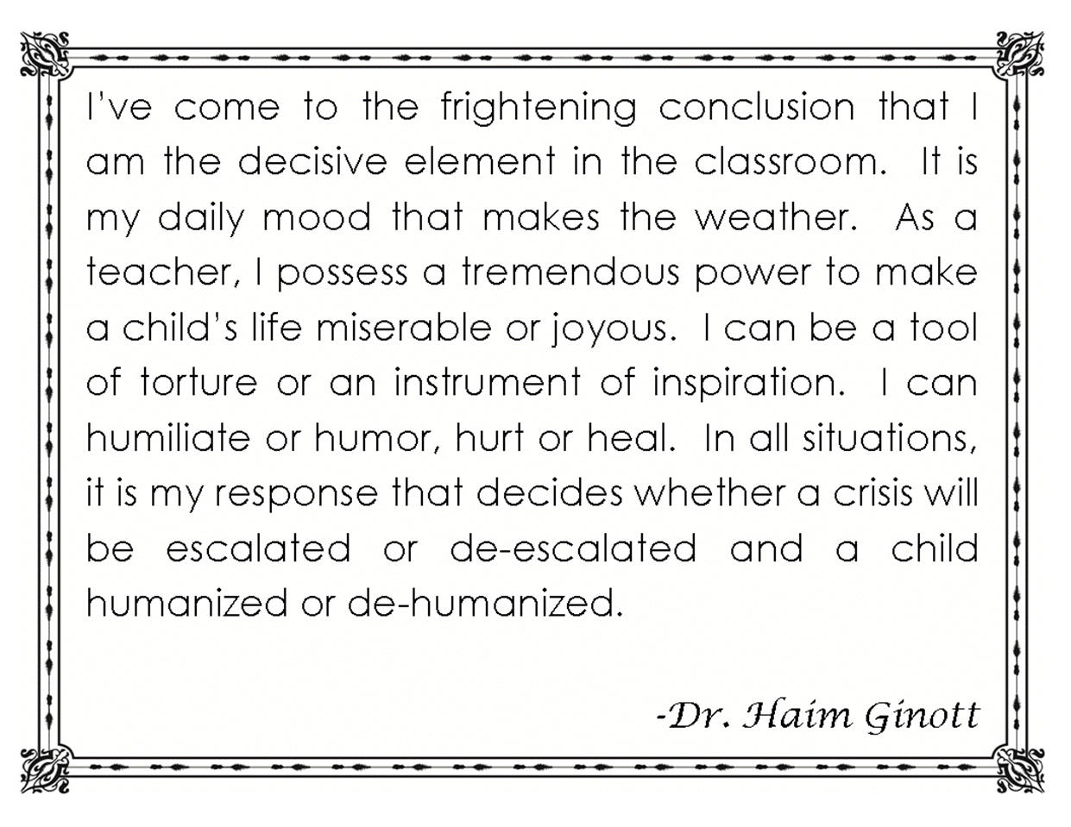
l

Slide 20
Relational Styles
Protective
Demanding
Supportive
l
Notes:
“Sparkling”?

Slide 21
Support
Support = Acknowledgement + Confidence
I can see: this is really hard for you; you’re feeling really anxious; you’re really struggling
I know: how determined you are; you can get through this
Let’s have a think about what we can do to make things easier? Let’s make a plan together
l

Slide 22
Presence
l

Slide 23
Three Dimensions of Presence
Physical, temporal presence: I am here, I won’t go away, I will return. I am available and anticipating your needs
Internal, embodied presence: I will bear my anxiety rather than giving in to it, I will overcome my anger by developing agency, I will remain calm, I persevere and am determined, I accept you; I face you rather than turning away, I will not give up on you. My body posture and tone of voice tell you I mean no harm and that I am determined. You matter to me, You will feel my strength.
Systemic presence: I will not keep secrets, I connect with other adults and will seek their support, I have agency in requesting the kind of support I need, my action is transparent, your support validates my position and authorises the action I take.
l

Slide 24
DEFERRED RESPONSE
USE FEWER WORDS
MESSAGES OF CONCERN/ SUPPORT/ BELONGING
RESPONSE NOT REACTION
PERSIST NOT INSIST
PRIORITISE

Slide 25
Unilateral action
I will be the person I want to be regardless of your provocation
I will not retaliate, I will choose when and how I respond
I will persist
I will gain strength from standing shoulder to shoulder with my colleagues and not from trying to have power over you
I will offer reconciliation gestures
I will respond from the position of ‘in our school’
Through my actions you will know that you matter and that you belong
l

Slide 26
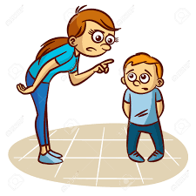
Insist vs Persist
Focus on what you are doing rather than what the child must or must not do
Insist
You must do as I say
Demands automatic obedience
Positions you for a power struggle
All about winning and losing
Persist
We must do as we say
Sets a limit that you can reinforce
Looks for gradual improvement
Doesn’t give up
l

Slide 27
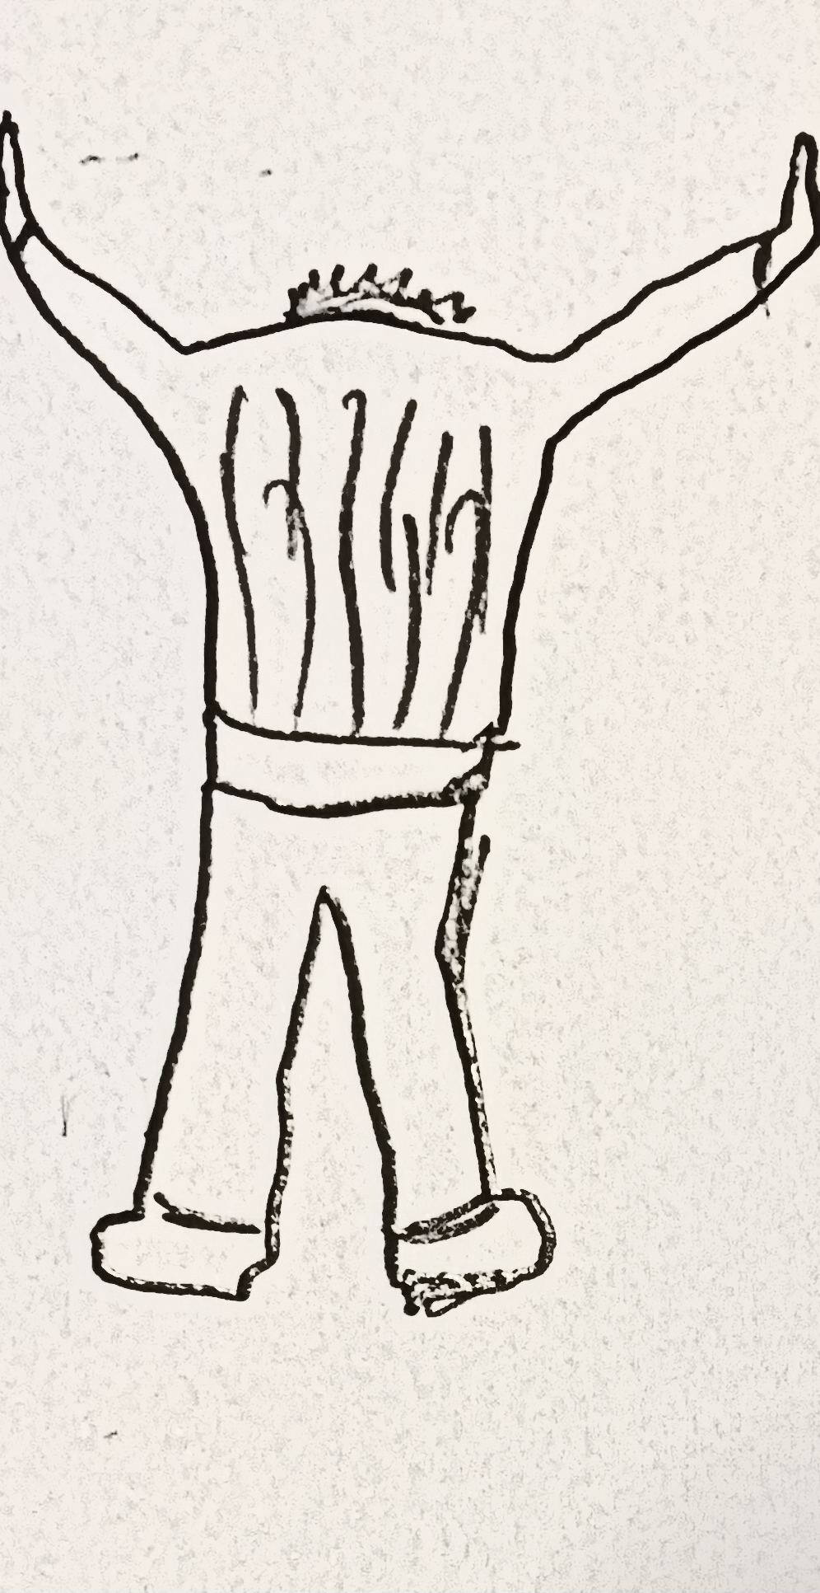
complementary escalation
passive helpless
compromise bribes
eggshells
symmetrical escalation
assertive aggressive
winning/losing threats
Presence

Slide 28
Vigilant care
l

Slide 29
Vigilant Care
Open Attention
Focused Attention
Protective Action
Children feel that they are in adults’ minds and have positive images of adults in their minds
A sliding scale in response to risky and dangerous behaviours
Transparency is key: telling the child that you will be supervising more closely and asking more questions
Through persistent engagement we look for gradual improvement.
l

Slide 30
Towards Vigilant Care
Presence
Response
Vigilant Care
Consequences
Exclusions
Sanctions
Punishments
l
Notes:
Change from language such as consequences explosion sanctions punishments to “responses” means that this situation can be addressed in its own right without having to have recourse to a behaviour policy which might restrict how staff can respond

Slide 31
Support
l

Slide 32
“The authority figure of the past thinks: ‘If I need outside help it means that I am weak.’ The new authority figure says: ‘My strength doesn’t come only from me but from the network that supports me and which I represent”
Omer (2011)
l

Slide 33
Why support matters
Support is vital to establish the authority of the adults and grant it legitimacy
Support allows the adults to act without escalation and aggression
Support expands the ability of the adults to exercise supervision
Support increases adults commitment to self-control
Support reduces isolation and builds a sense of belonging
l

Slide 34
Network Presence
Involving the parents
Involving other pupils
Involving external agencies
Avoiding the privacy reflex: transparency
l

Slide 35
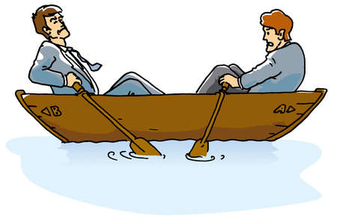
Working collaboratively…
A shared understanding – a common goal
Sharing positives as well as difficulties
Develop a common language that explains how they can reinforce each others position so that the child can feel a sense of security and belonging
Adopt a policy of transparency
l

Slide 36
Relational / Reconciliation Gestures
I will keep trying and caring no matter what… unconditional
Not based on the response of the child
No strings attached
Not a reward
To be offered any time
l

Slide 37
Community and statutory organisation
Families and carers
Each other
Leadership
Other students
staff
pupils
“
l

Slide 38
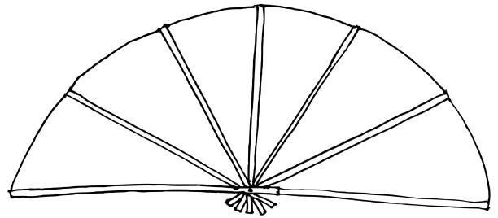
Anchoring in Schools
Resistance
Self- Control
Support
Presence
Connection
Transparency
Structure
l
Vormingsnetwerk Nieuwe Autoriteit En Geweldloos Verzet of School
Notes:
When things go wrong: what are we already doing in each of these areas? What can we do?
Provokes a conversation around culture
What are you hoping to achieve?

Slide 39
l

Slide 40
l

