Slide 1

Neurodiversity: Challenges, Masking and Acceptance
Martha Winterflood MSc
School counsellor at KSA

Slide 2

WORKSHOP STRUCTURE
My approach What is Neurodiversity ASD and ADHD Perspectives and attitudes Case studies High masking What can I do?
2

Slide 3

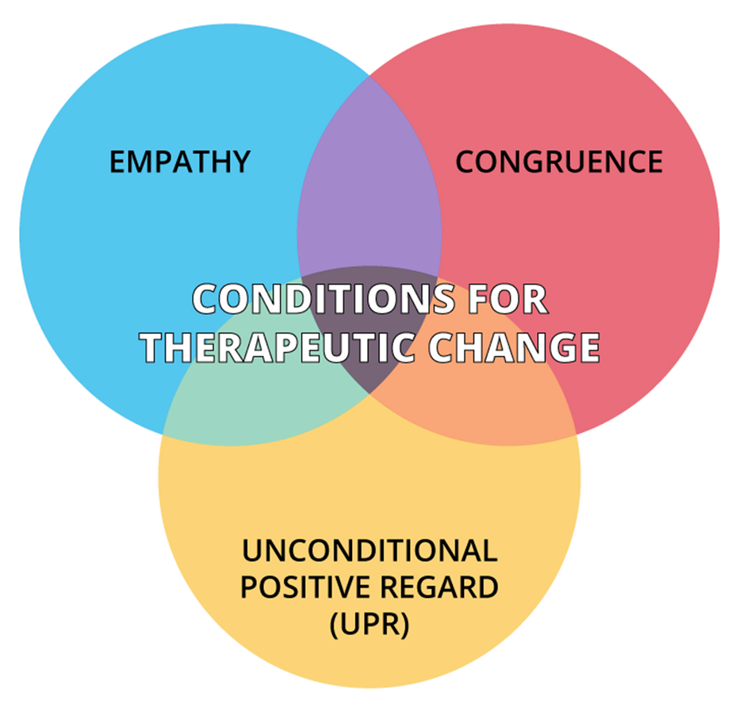

MY APPROACH
Person-centred theory
and Attachment theory, informed by interpersonal neurobiology
3

Slide 4
WHAT IS NEURODIVERSITY?
4

Slide 5


DEFINITIONS OF NEURODIVERSITY:
The variation in human brains and nervous systems. It is the idea that there is no one right way for the brain to function, and that the many different ways that people think, learn, and behave are all normal and valuable
Different thinking styles that affect how people communicate with the world around them. It is also an umbrella term - a word that sums up lots of different things. It includes autism, ADHD, dyslexia, dyspraxia, dyscalculia and Tourette's.
5

Slide 6
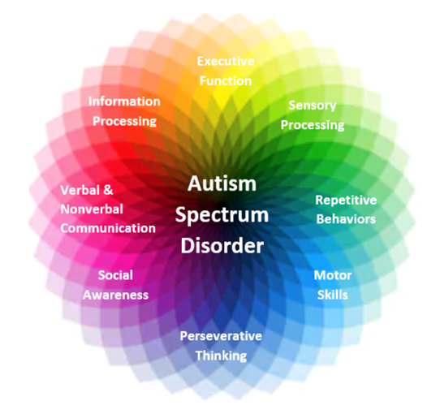
AUTISM SPECTRUM DISORDER (ASD)
A lifelong neurological condition characterised by social and communication difficulties, repetitive and restrictive behaviour, sensory processing differences, highly focused interests and meltdowns/shutdowns.
6

Slide 7

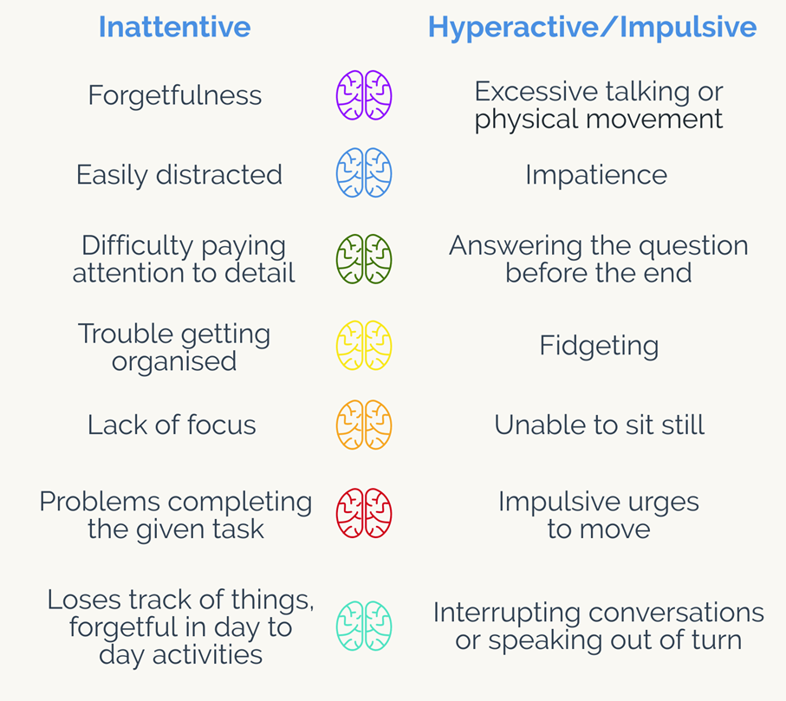

ATTENTION DEFICIT
HYPERACTIVITY DISORDER (ADHD)
A lifelong neurological condition characterised by inattentive and/or hyperactive behaviours which that make it difficult to function on a day-to-day basis.
7

Slide 8
PERSPECTIVES OF NEURODIVERSITY
A recent thing?
An Excuse?
Everybody has something these days?
An answer?
A lifeline?
8

Slide 9
CASE STUDY: JOEY
Joey is a 10-year-old boy in year 6 who is always on the go and has excess energy. He is a likable, popular boy in his class but often gets into trouble at school. Joey is constantly moving, getting out of his seat, talking when he should be quiet, losing focus and distracting others.
In the playground, Joey can also find himself in physical altercations, having difficulty inhibiting his anger when another child frustrates him. Joey is also enjoys in particular things for a short period of time before quickly losing interest, such as gymnastics, football, painting and boxing. However, Joey is very good at coming up with new ideas and creates exceptional creative stories.
9

Slide 10
CASE STUDY: POPPY
Poppy is a 13-year-old girl in year 8 who has always found school difficult. She has always been very socially awkward and had few friends. Typically, Poppy finds social times very tough, not only due to her difficulty socialising but due to the unstructured nature and noise. To help cope with this, Poppy has been allowed to stay in the library at break and lunch, as well as wearing ear defenders when in busy situations. Poppy does, however, enjoy physics lessons, where she excels. Poppy will also do independent physics work at the weekends and has memorised as many formulas and theoretic models she can find.
10

Slide 11
CASE STUDY: GEORGIA
Georgia is a 15-year-old girl in year 10. She is a bright, bubbly, conscientious student who always works hard in her lessons. She is in 2nd set for all subjects, achieving well all around and has been described as a perfectionist. Georgia also is very friendly with teachers and will talk very eloquently with them, often chatting with the class teacher before or after lesson time.
Georgia has had the sameone friend from reception, Chloe, and has stayed best friends with her for the last 10 years. Georgia has become part of a friendship group of 7 girls, being introduced to these friends by Chloe. However, this group can often have arguments, with Georgia calling people out for doing things morally wrong but nevertheless stays friends with them.
When asking mum about Georgia, she says that she never sits still and always must be busy. She has become increasingly more difficult at home, having very heightened arguments multiple times a week. At these times, Georgia will cry, hyperventilate, rocking backwards and forwards and occasionally covering her ears so she cannothear others speaking to her. Mum has recently realised that these arguments appear to stem from Georgia being very stubbornand rigid over particular things such as her clothing and food. If anyone where to challenge this, such as going out for food, buying her new clothes or having a different brand of cereal, this will cause one of these arguments.
11

Slide 12
MASKING
A coping strategy used by autistic individuals to navigate social situations and fit in with neurotypical expectations Can be commonly misdiagnosed as:
  Anxiety, depression, OCD or an Eating disorder
More “mainstream” special interests
Comes out at home
  Common amongst females
However, masking can then lead to further adverse mental health effects
12

Slide 13
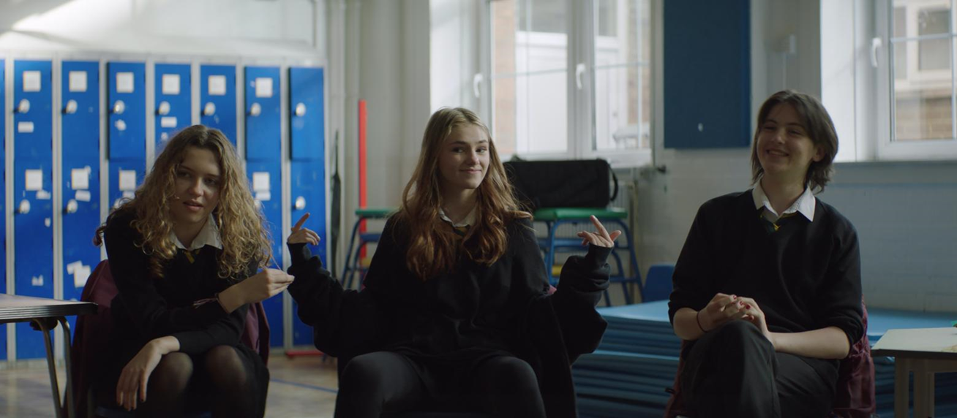
DIVERSITY BRINGS NEW PERSPECTIVES.
•Me, My Autism & I | Vanish & Ambitious about Autism | Hero Film
13

Slide 14
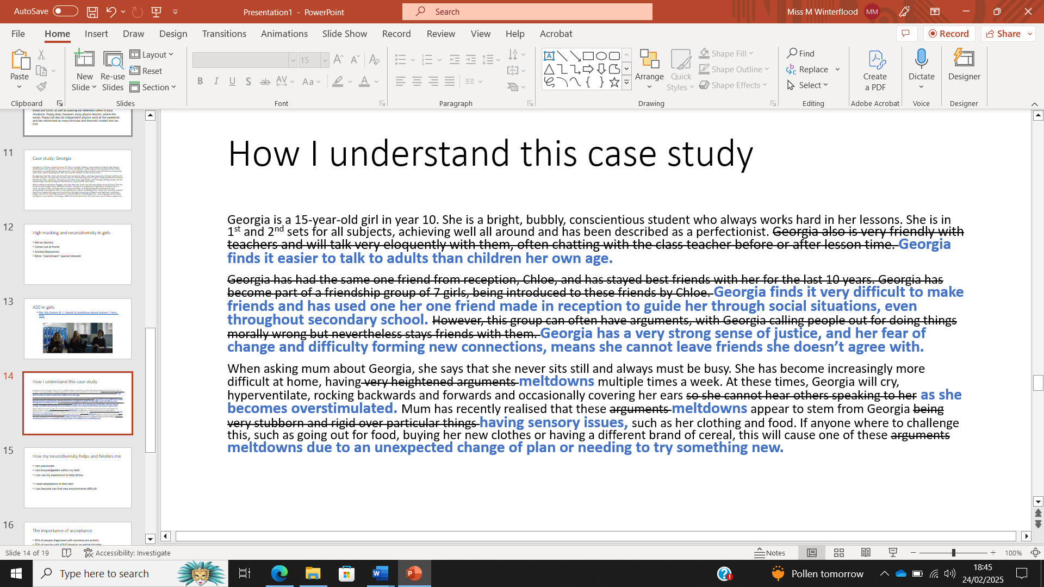
CASE STUDY: GEORGIA
14

Slide 15



HOW MY NEURODIVERSITY HELPS AND HINDERS ME
I am passionate
I need adaptations to feel calm
I am knowledgeable within my field
I can find new environments
overwhelming
I can use my experience to help others
15

Slide 16
THE IMPORTANCE OF ACCEPTANCE
30% of people diagnosed with anorexia are autistic 20% of people with ADHD develop an eating disorder 66% of autistic people have had thoughts of suicide 11% of all completed suicides are by autistic people 25% of young people who have completed suicide have ASD or ADHD
16

Slide 17




SO WHAT CAN WE DO?
•Being educated (you don’t know what you don’t know)
•Thinking deeper and considering your own and others frame of reference
•Knowing the risks
•Encourage authenticity and where possible lead by example
17

Slide 18
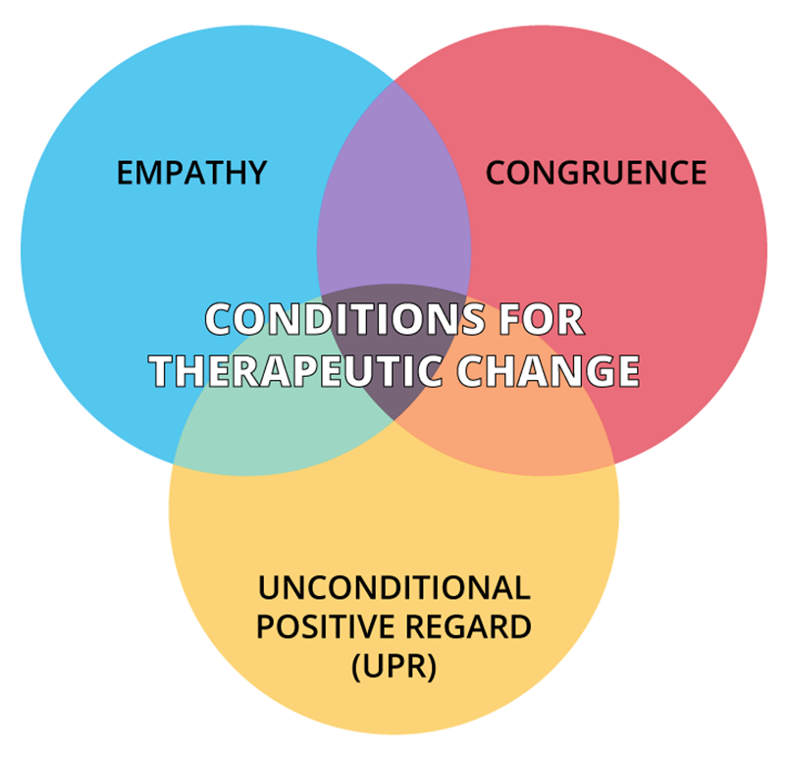
18

Slide 19
THANK YOU FOR LISTENING!
19

