Slide 1
Leading inclusion: what works?
Katherine Walsh
Director of Inclusion - River Learning Trust
Regional SEND Leader - Whole School SEND
Chair - CST SEND and Inclusion Professional Community

Slide 2
In today’s session:
Identify some of the challenges in enacting inclusive provision
Highlight the opportunities these challenges enable
Review key solutions:
Implementing a distributive leadership of SEND
Celebrating a teacher’s power: noticing

Slide 3
River Learning Trust
30 Schools
10 secondary schools
4 joined RI/I
20 primary schools
9 joined RI/I
Teaching School Hub
SCITT
16,000 pupils

Slide 4
River Learning Trust
A diverse range of schools
Oxfordshire and Swindon
2000+ to 100 pupils
Rural and urban
<10% to >65% Pupil Premium
<1% to > 5% EHCP

Slide 5
Reviewing inclusivity
Identification of SEND
SENDCO role & experience
Headteachers’ previous experience
Attendance
Informal observations
Feedback, e.g. SCPs, Ofsted
Listening / addressing language used
Notes:
Identification of SEND
SENDCo role in RLT schools - leadership? hours/week?
SENDCo experience - years of experience? more than one school?
Headteachers’ previous experience
Support and Challenge Partner feedback and observations
Ofsted findings in most recent inspections
Listening to (and addressing) the language used by school staff

Slide 6
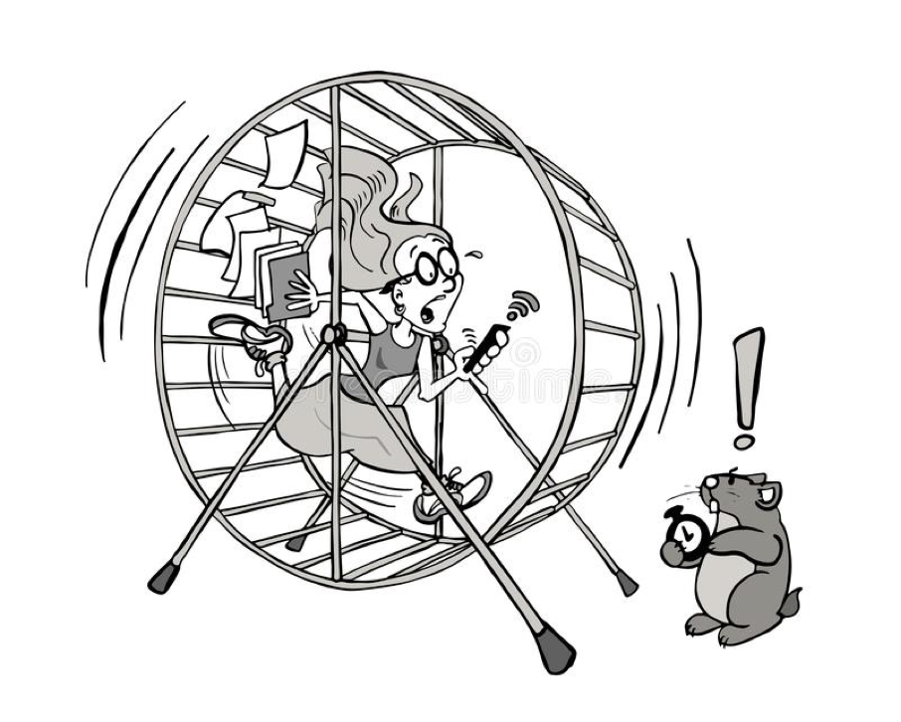
The Role of the SENDCO

Slide 7
The Hamster Wheel… Why?
9,092,073 pupils in schools in England
1,673,205 of those have a SEND (18.4%)
434,354 have EHCPs (4.3%)
54.4% pupils with EHCPs in mainstream
EPI: 39% SEND at some point

Slide 8
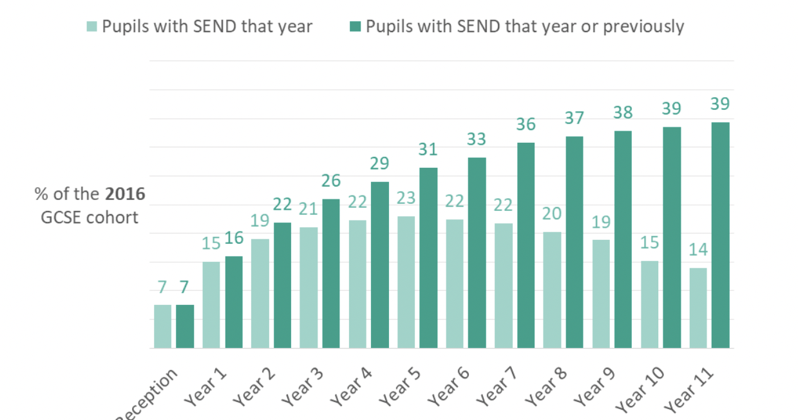
EPI: 39% at some point
Source: Education Policy Institute - How many children have SEND? Hutchinson (2017)

Slide 9
Primary:
3% EHCP
14.1% SEN Support
Secondary:
2.7% EHCP
12.9% SEN Support

Slide 10
Reception
Year 1
Year 2
Year 3
Year 4
Year 5
Year 6

Slide 11
Year 7

Slide 13
Inclusive Challenges
Staff knowledge
Staff confidence
Communication
Existing school systems
Waiting lists for external agency advice and support
Funding…

Slide 15
Challenge
Opportunity

Slide 16
Long-term outcomes
The Institute of Health Equity’s Report ‘A Fair and Supportive Society’ brings to life the shocking long-term outcomes for people with learning disabilities - they are:
less likely to be in work: only 5.7% of people with a learning disability who are known to their local authority have paid work
more likely to be in prison: despite just 2.9% of the whole population having learning disabilities, a quarter of young people in custody have learning disabilities
more likely to live socially isolated, lonely lives: 50% of people with a learning disability experience chronic loneliness, compared with around 15–30% of people in the general population. Loneliness is associated with depression and stress, high blood pressure and higher mortality risk
more likely to die 15-20 years sooner.

Slide 17
Innovating solutions

Slide 18
Every teacher a teacher of SEND.
Every leader a leader of SEND.
The SENCO provides professional guidance to colleagues and will work closely with staff, parents and other agencies. The SENCO should be aware of the provision in the Local Offer and be able to work with professionals providing a support role to families to ensure that pupils with SEN receive appropriate support and high quality teaching.

Slide 19
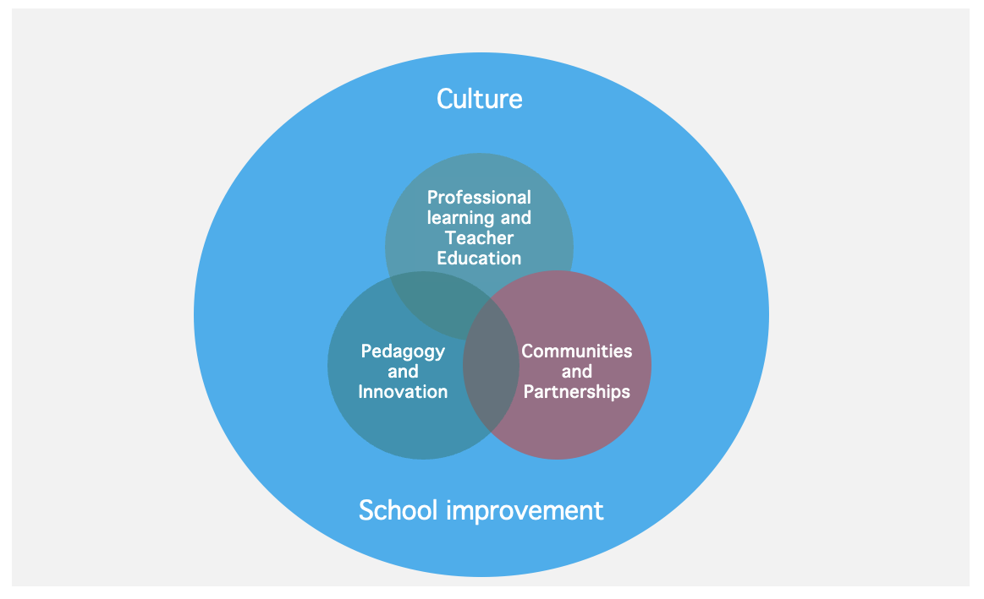
Learners with SEND

Slide 20
Learners with SEND

Slide 21
SEND in mainstream schools
It is tempting to talk about the challenge of SEND as a specific and distinct issue.
Yet, far from creating new programmes, the evidence tells us that teachers should instead prioritise familiar but powerful strategies, like scaffolding and explicit instruction, to support their pupils with SEND.
-Professor Becky Francis
Notes:
We are not the finished product!
This is something that is a work in process…

Slide 22
RLT Inclusion Strategy
SEND and AP Improvement Plan:
Fulfill children’s potential
Build parents’ trust
Provide financial sustainability
RLT Core Principles:
We will be truly inclusive for all pupils, students and trainees, offering a rich and excellent educational experience whatever their academic ability, social background or special educational need.
RLT Strategic Education Plan:
2c: Improving provision for our pupils with SEND with strategic leadership and support for schools

Slide 23
RLT Inclusion Strategy
Quality First Teaching
Capturing the voice of ‘experts by experience’ to develop and refine trust-wide systems and school-based provision
Alternative Provision
Specialist Support
Teaching Assistant workforce development
Liaison and strategic planning with stakeholders

Slide 24
RLT Inclusion Strategy
Quality First Teaching - SEND is everyone’s responsibility
Teaching and Learning Strategy: School leaders have access to additional, scaffolded guidance on best practice for pupils with SEND in mainstream lessons
Capacity building: Training for SCPs to support the QA of inclusive teaching practice
Distributed leadership: Training for school leaders: Headteachers, SENDCOs, Subject Leaders
SENDCO Workload: Developing systems to enable SENDCOS to have more time in classrooms
Transition: Enabling conversations between primary and secondary leaders to improve pupil understanding at transition (pupil need and curriculum)
Increasing wider curriculum opportunities, e.g. inclusive sports days

Slide 25
Built in, not bolt on

Slide 26
Child 1 | Child 2 | Child 3 | Child 4 | Child 5 | Child 6
Visual timetable Explain changes in routine Clear expectations Chunked, dual coded instructions Behaviour specific praise Preteaching Use of scripts for problem-solving Movement breaks Worked examples/ manipulatives / memory aids Extra time to complete tasks Preferential seating | Chunked, dual coded instructions Behaviour specific praise Opportunities for overlearning Preteaching Movement breaks Worked examples/ manipulatives / memory aids Extra time to complete tasks Avoid copying from the board Preferential seating | Visual timetable Explain changes in routine Clear expectations Chunked, dual coded instructions Behaviour specific praise Opportunities for overlearning Preteaching Movement breaks Worked examples/ manipulatives / memory aids Extra time to complete tasks Preferential seating | Explain changes in routine Chunked, dual coded instructions Behaviour specific praise Opportunities for overlearning Preteaching Use of scripts for problem-solving Worked examples/ manipulatives / memory aids Extra time to complete tasks Preferential seating | Visual timetable Chunked, dual coded instructions Behaviour specific praise Opportunities for overlearning Preteaching Worked examples/ manipulatives / memory aids Extra time to complete tasks Avoid copying from the board Preferential seating | Visual timetable Explain changes in routine Clear expectations Chunked, dual coded instructions Behaviour specific praise Preteaching Use of scripts for problem-solving Movement breaks Worked examples/ manipulatives / memory aids Extra time to complete tasks Preferential seating

Slide 27
Proactive planning
Almost 3/4 of learners with SEND are likely to have difficulties with elements of:
Working memory
Language development
Executive functioning, e.g. planning, personal organisation, prioritising, self-checking, flexible thinking, impulse control and emotional regulation.

Slide 28
High-quality teaching - EEF
Five recommendations:
Flexible grouping
Cognitive and metacognitive strategies
Explicit instruction
Use of technology
Scaffolding

Slide 29
Child 1 | Child 2 | Child 3 | Child 4 | Child 5 | Child 6
Visual timetable Explain changes in routine Clear expectations Chunked, dual coded instructions Behaviour specific praise Preteaching Use of scripts for problem-solving Movement breaks Worked examples/ manipulatives / memory aids Extra time to complete tasks Preferential seating | Chunked, dual coded instructions Behaviour specific praise Opportunities for overlearning Preteaching Movement breaks Worked examples/ manipulatives / memory aids Extra time to complete tasks Avoid copying from the board Preferential seating | Visual timetable Explain changes in routine Clear expectations Chunked, dual coded instructions Behaviour specific praise Opportunities for overlearning Preteaching Movement breaks Worked examples/ manipulatives / memory aids Extra time to complete tasks Preferential seating | Explain changes in routine Chunked, dual coded instructions Behaviour specific praise Opportunities for overlearning Preteaching Use of scripts for problem-solving Worked examples/ manipulatives / memory aids Extra time to complete tasks Preferential seating | Visual timetable Chunked, dual coded instructions Behaviour specific praise Opportunities for overlearning Preteaching Worked examples/ manipulatives / memory aids Extra time to complete tasks Avoid copying from the board Preferential seating | Visual timetable Explain changes in routine Clear expectations Chunked, dual coded instructions Behaviour specific praise Preteaching Use of scripts for problem-solving Movement breaks Worked examples/ manipulatives / memory aids Extra time to complete tasks Preferential seating

Slide 30
Autism | Dyslexia | ADHD | Perceptual Reasoning Difficulties | Language Delays | Anxiety
Visual timetable Explain changes in routine Clear expectations Chunked, dual coded instructions Behaviour specific praise Preteaching Use of scripts for problem-solving Movement breaks Worked examples/ manipulatives / memory aids Extra time to complete tasks Preferential seating | Chunked, dual coded instructions Behaviour specific praise Opportunities for overlearning Preteaching Movement breaks Worked examples/ manipulatives / memory aids Extra time to complete tasks Avoid copying from the board Preferential seating | Visual timetable Explain changes in routine Clear expectations Chunked, dual coded instructions Behaviour specific praise Opportunities for overlearning Preteaching Movement breaks Worked examples/ manipulatives / memory aids Extra time to complete tasks Preferential seating | Explain changes in routine Chunked, dual coded instructions Behaviour specific praise Opportunities for overlearning Preteaching Use of scripts for problem-solving Worked examples/ manipulatives / memory aids Extra time to complete tasks Preferential seating | Visual timetable Chunked, dual coded instructions Behaviour specific praise Opportunities for overlearning Preteaching Worked examples/ manipulatives / memory aids Extra time to complete tasks Avoid copying from the board Preferential seating | Visual timetable Explain changes in routine Clear expectations Chunked, dual coded instructions Behaviour specific praise Preteaching Use of scripts for problem-solving Movement breaks Worked examples/ manipulatives / memory aids Extra time to complete tasks Preferential seating

Slide 31
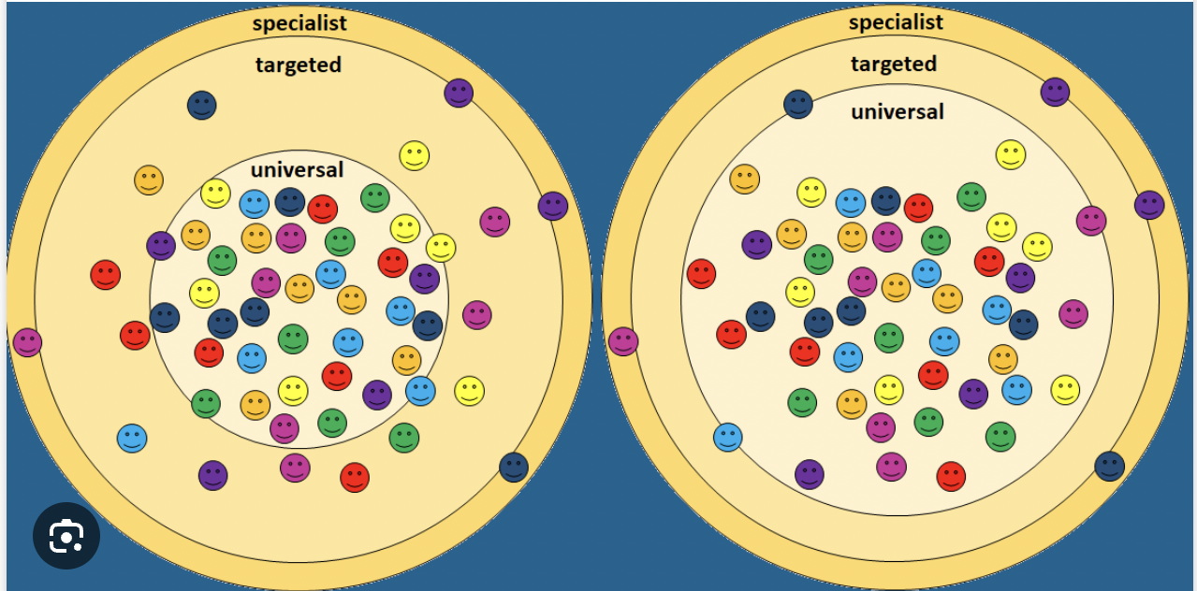

Slide 32
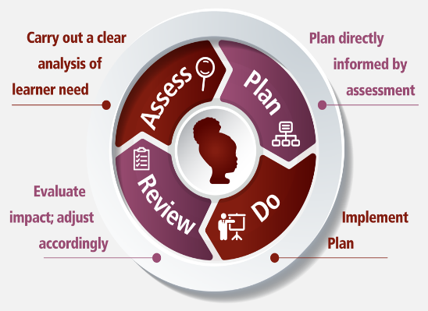
The Graduated Approach

Slide 33
You notice…
…a child is making less progress than would be expected
…a new behaviour that is preventing a child from learning.
What can you do?
Talk to the child
Talk to the child’s family
Talk to the previous teacher or another subject teacher
Take notice of the child – what is preventing their progress?
Is it in all lessons, or some? Certain times of day?
Adapt your teaching
Provide additional structure to the lesson/environment
Provide additional scaffolding to tasks
Talk to the subject leader or phase leader
Talk to the SENCO
Assess
Review
Plan
Do

Slide 34
Data is beginning to show impact
A review of 2023-2024 data identifies that pupils with SEND in RLT schools are, in some instances, performing better than pupils with SEND nationally.
Phonics: Pupils with SEND significantly above national (43% national, 52% RLT)
GCSE:
Grade 5+ Eng & Maths: above 2023 national average for pupils with SEND (17% national 17%, 23.1% RLT).
P8: above 2023 national for pupils with SEND (national -0.62, RLT -0.56)
A8: above 2023 national for pupils with SEND (national 28, RLT 30.3)

Slide 35
RLT Inclusion Strategy
Quality First Teaching - SEND is everyone’s responsibility
Workforce redesign
Strategic use of data
Leadership of SEND Guidance

Slide 36
Our focus needs to switch from...
What the child can’t do…
What can we do?

Slide 37
Universal SEND Services Programme
Click each logo for more info.
Open access for all
Participation through recruitment
Participation by invitation
Online SEND CPD units
Responsive webinars
Specialist Spotlight
PD Groups
PfAEY
Peer Mentoring
Community Join-Up
Regional networking
30 mins online learning to support workforce confidence in meeting range of barriers to learning. Certificate system for completion of units. 19 units currently available.
Webinars, responsive to the needs of the sector. Recent titles include: Positively
responding to increasing complexity in
mainstream schools, Navigating school to career transitions
Online discussion sessions to contextualise and extend understanding linked to online SEND CPD unit titles. Each session is attended by a specialist, including Educational Psychologists, Speech Therapists
Sector-led school / college improvement activities. 24 groups, to include bespoke regional groups (working with established groups of schools e.g. MATs) and open national groups. 5 group sessions + 1:1 conversations.
Support for settings and individuals to review Preparation for Adulthood practice. Identifying and exemplifying good practice.
Support for school leaders in mainstream schools following an RI Ofsted judgement where SEND is an area for improvement.
National and regional network meetings to, with a focus on PfA including into employment: sharing best practice and identifying gaps in provision.
Regionalised model of delivery and development, responsive to local context through regional team of experienced, school-based SEND leaders in each region of England.
Overview
Inclusive practice in m/s
Inclusive practice in m/s
Inclusive practice in m/s
Inclusive practice in m/s
Inclusive practice in m/s
Inclusive practice in m/s
Cross sector, phase, organisational relationships
Inclusive practice in m/s
Workforce confidence
Workforce confidence
Workforce confidence
Workforce confidence
Workforce confidence
Workforce confidence
Cross sector, phase, organisational relationships
Impact
Early and accurate identification of need
Early and accurate identification of need
Early and accurate identification of need
Leadership of SEND
Leadership of SEND
Leadership of SEND
Identify and share good practice
Preparation for Adulthood
Preparation for Adulthood
Preparation for Adulthood
Preparation for Adulthood
Preparation for Adulthood
Preparation for Adulthood
Preparation for Adulthood
Identify and share good practice
Visit Universal SEND Services | Whole School SEND for full details and to access CPD

Slide 38
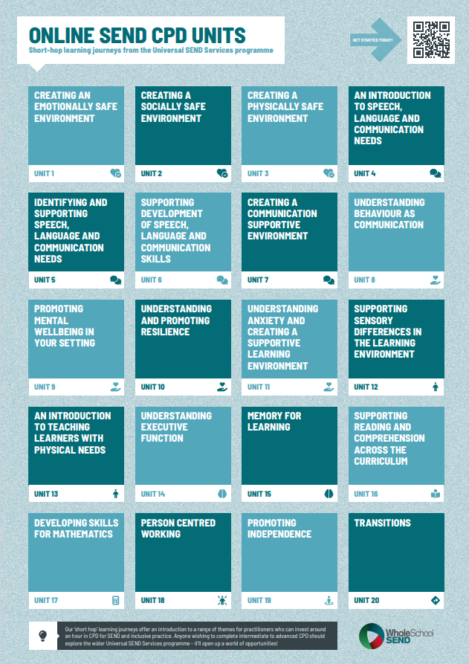
Online CPD units
Sign up / login here:
https://www.wholeschoolsend.org.uk/page/online-cpd-units

Slide 39
Universal SEND Services programme: Professional Development Groups
Regional groups of practitioners, supported to engage in evidence-informed, SEND based, school/setting improvement projects:
Five virtual group meetings with a Regional Lead
Identify a project
Design an implementation plan
Implement the plan
Gather evaluation data
Evaluate outcomes and impact
Up to three 1:1 professional conversations with a Whole School SEND regional leader.
Find out more here: https://www.wholeschoolsend.org.uk/school-improvement-send
Notes:
2

Slide 40
Thank you
@WholeSchoolSEND
Whole School SEND
info@wholeschoolsend.co.uk
Whole School SEND
www.wholeschoolsend.org.uk

